Slide 1

Sage
Designing for an Active Transition into a Retirement Lifestyle
Adam Barry, Amy Chang, Ethan Hellman, Brendan McLoughlin
CS 147 · F23 · Stanford University

Slide 2
Outline
Problem & Solution Values in Design Tasks Usability goals & metrics Revised Interfaces Sketches Medium-fi task flows Prototype Implementation

Slide 3
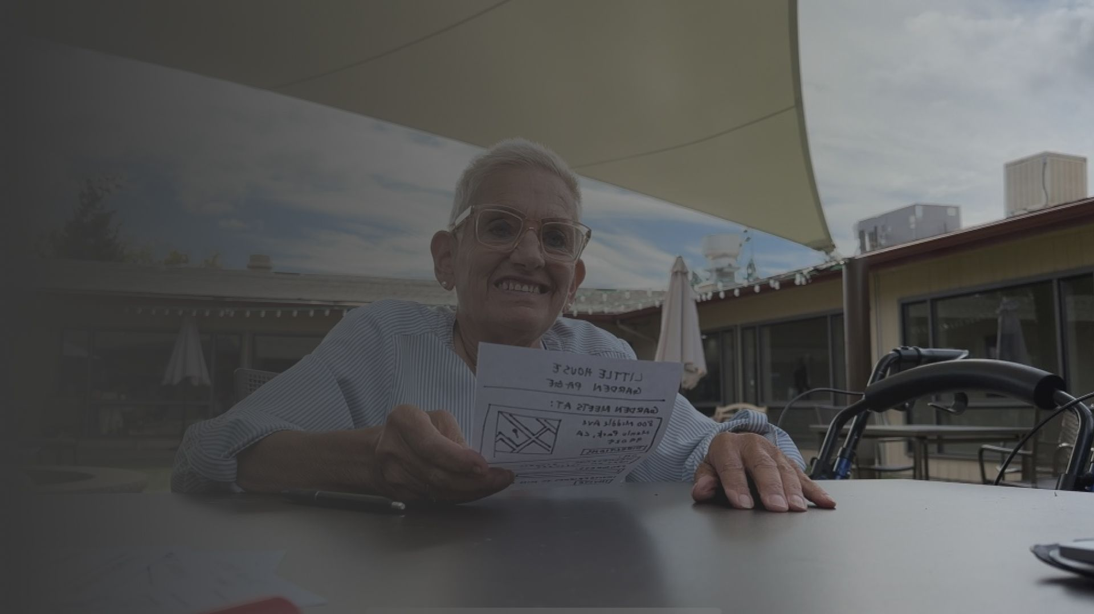
Values in Design
Its about people, not plants Gentle accountability Extreme accessibility

Slide 4

Tensions
“Subtlety” runs in the face of large buttons and full sentences Is accountability at odds with friendship formation?

Slide 5
THE PROBLEM
Elderly people who lack community and contribution to something bigger than themselves often feel lonely and purposeless.

Slide 6

Problem & Solution
Needs & solution
NEEDS
Create sense of purpose
Prevent loneliness
SOLUTION
App that organizes shared gardens & strengthens community

Slide 7
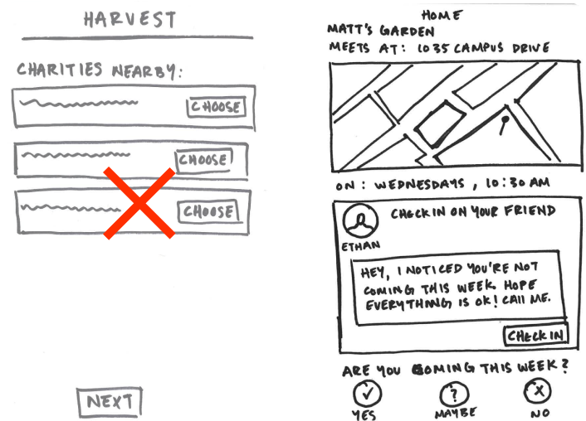
Values in Design
It’s about people, not plants
Accountability flow instead of harvest flow
Decided to revisit harvest task flow and scrap it...because it didn’t achieve that value

Slide 8
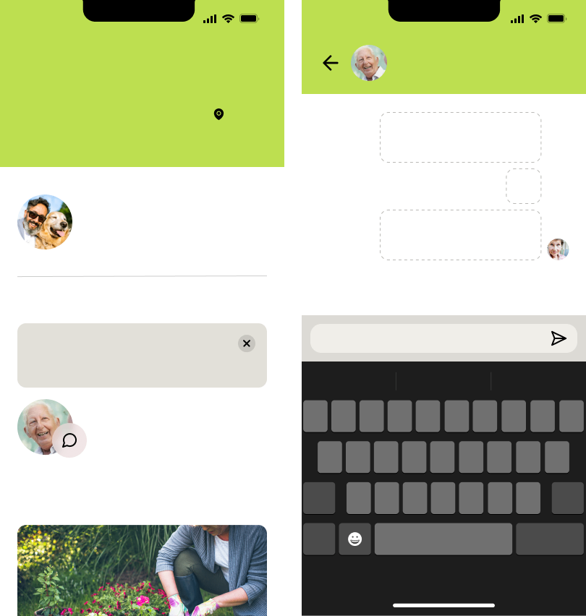
Values in Design
9:41
9:41
Jack
Marie
Joe
Nancy
Bob
Matt’s Garden
Edit
Gentle Accountability
Meets at
Little House Garden
at
Invite
We’ll miss you this week! Can you come next week?
3:30pm
on
Fridays
Not Attending
❤️
Wish you could be there this week!
Being ~missed~
David
Hasn’t Responded
Rather than strict attendance feature, want something subtle that people can act on...a small thing to make someone feel seen
Message Bob and Joe to let them know you will miss seeing them this week!
Message Bob
Miss you
❤️
Keyboard
q
w
e
r
t
y
u
i
o
p
Bob
a
s
d
f
g
h
j
k
l
Pictures
z
x
c
v
b
n
m
123
space
return

Slide 9
Values in Design
Extreme Accessibility
Larger Buttons (Salman et al., 2022) Higher Contrast (Alsswey & Al-Samarraie, 2019) Full-Sentence Instructions (Chia et al., 2018) Simplicity & Clarity (Alsswey et al., 2022) Blue and Green Confusion (Kvitle et al., 2016)

Slide 10


VALUE PROP
Creating newfound purpose and friendships through gardening

Slide 11
Tasks

Slide 12
Med-Fi Prototype

Slide 13
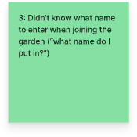
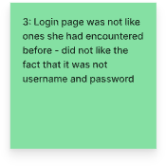
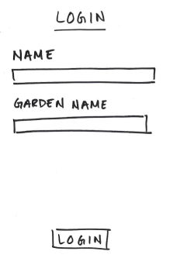
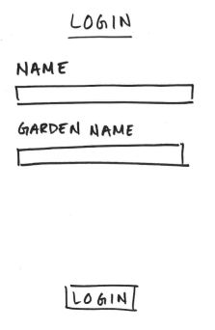
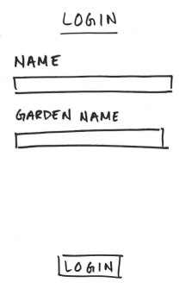
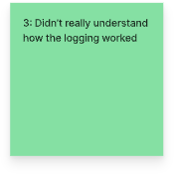
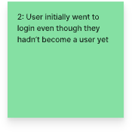
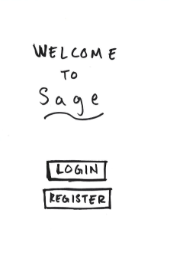
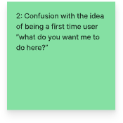
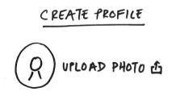
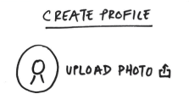
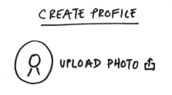
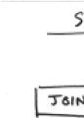
Tasks
Annotated Task Flows
Marie Apple
Marie Apple
Jilli’s Garden

Slide 14
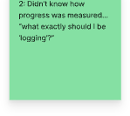
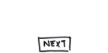
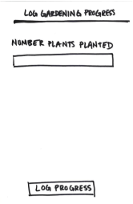
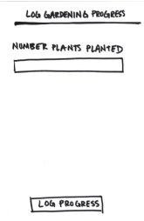
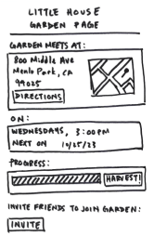
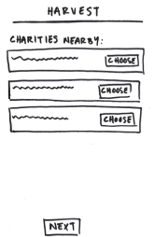
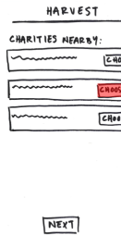
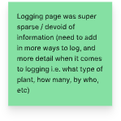
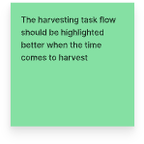
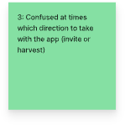
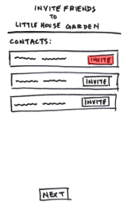
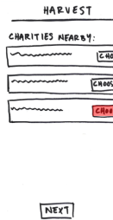
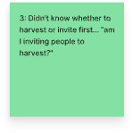
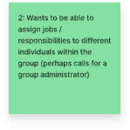
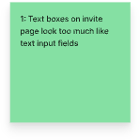
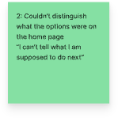
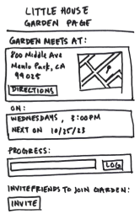
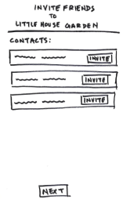
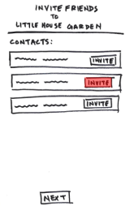
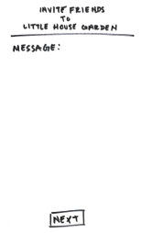
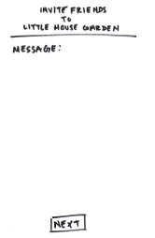
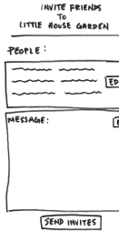
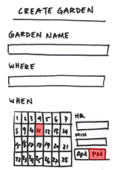
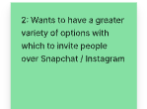

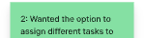
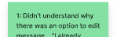
Tasks
Annotated Task Flows
9
Please come join my garden! We meet every Wednesday at 3pm.
Jilli’s Garden
Please come join my garden! We meet every Wednesday at 3pm.
Little House Center
09
33

Slide 15
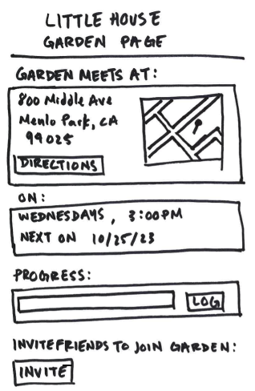
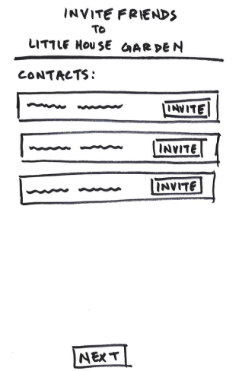
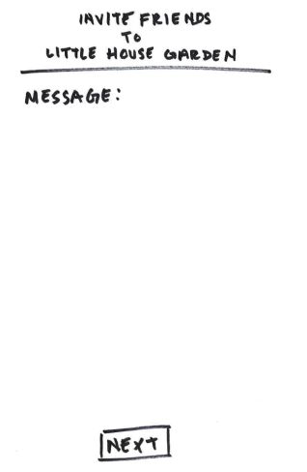
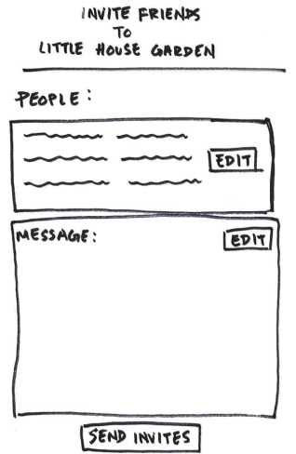



Old LoFi Prototype
Simple Task Flow
Please come join my garden! We meet every Wednesday at 3pm.
Please come join my garden! We meet every Wednesday at 3pm.
Invite new group members

Slide 16
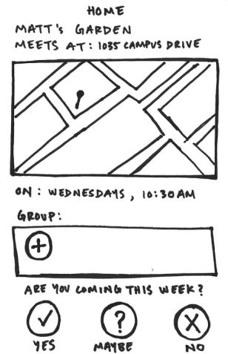
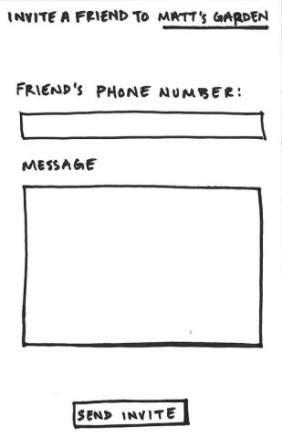
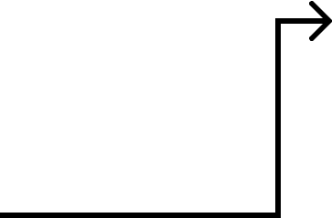
Resvised LoFi Prototype
Simple Task Flow
Invite new group members

Slide 17

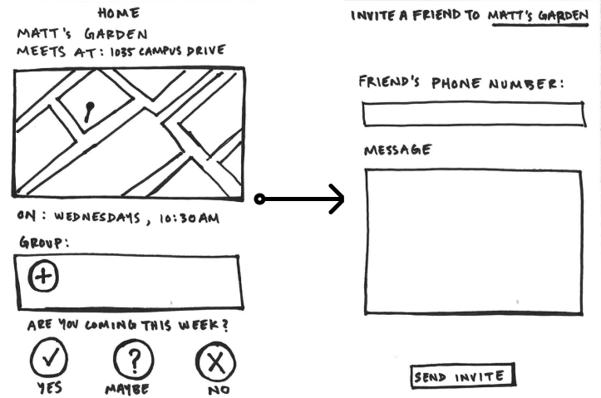
Resvised LoFi Prototype
Simple Task Flow
Changes
Invite Button is next to group members Simplified to a two screen process
Rationale
Drastically simplified process that leans into traditional UI patterns with Ease of Learning, Efficiency of Use, and Memorability
Invite new group members

Slide 18









Resvised LoFi Prototype
Moderate Task Flow
Join Sage and find when and where to garden

Slide 19

Resvised LoFi Prototype
Moderate Task Flow
Changes
Simplified login process to mirror standard login process Changed date and time selection to avoid confusion
Rationale
Ease of Learning improved via use of simple, traditional onboarding UI patterns Unified home screen makes high priority info extremely easy to find (Efficiency of Use, Memorability)
Join Sage and find when and where to garden

Slide 20





Resvised LoFi Prototype
Complex
Matt’s Phone
Matt’s Phone
Ethan’s Phone
Let your group members know that “I miss you ”

Slide 21

Resvised LoFi Prototype
Complex
Changes
Changes complex task flow from harvest to check-in Consolidated information to home page for simplicity Call to action to check in with absent members
Rationale
Ease of Learning improved given that harvest functionality not intuitive, attendance more comprehensive Unified home screen makes high priority info extremely easy to find (Efficiency of Use, Memorability) Error Rate and Severity lowered given fewer screens should invite fewer errors Satisfaction increased given group member section requested
Let your group members know that “I miss you ”

Slide 22














Old LoFi Prototype
Moderate Task Flow
Jilli’s Garden
Join Sage and find when and where to garden

Slide 23








LoFi Prototype
Complex Task Flow
Distribute harvested food to the community

Slide 24

MedFi Prototype Before Feedback
Go Back
Go Back
Settings
Go Back
Settings
Welcome to
Welcome to
Matt’s Garden
Private Chat with Matt
Sage
Sage
Meets at 1035 Campus Drive on Wednesdays at 10:30 AM
Sage
Username
Hi Matt! I saw you weren’t making it to the meeting. Are you okay?
Choose a username
New Members
Password
Choose a password
Marie
Matt
John
Returning Members
Confirm Password
Confirm your password
It looks like Matt won’t be able to make it this week. Would you like to check in on Matt?
Join
Check In
Message...

Slide 25

MedFi Prototype After Feedback
9:41
9:41
9:41
9:41
Sage
Back
5/7
Sage
Matt’s Garden
Edit
Select Garden
Select a home base garden for your group. Allow Sage to access your location so we can find some gardens in your area.
Meets at
Little House Garden
at
3:30pm
on
Fridays
Private Garden
Are you coming this Friday?
Enter the address of your private garden
Yes
No
Maybe
OR
Little House Garden
Local Garden
Mondays & Wednesdays at 3:30
Attending this week
Garden Together.
Search garden names or locations
Congrats! You’re in.
Organize a gardening group in minutes and work towards your very own harvest.
Little House Garden
Jack
Marie
Nancy
Invite
0.5 miles away · 5 min drive
Not Attending
View Details
Jeremy’s Community Garden
Message Bob and Joe to let them know you will miss seeing them this week!
Create Account
0.5 miles away · 5 min drive
View Details
Log In
Continue
Go Home
Little House Garden
Bob
0.5 miles away · 5 min drive

Slide 26
MedFi Prototype After Feedback
Main Changes
Usability Progress
Traditional UI
Ease of Learning & Efficiency
High contrast color choices
Accessibility
Use of typography, colors, and UI blocking to prioritize information
Memorability and Accessibility

Slide 27

Moderate Task Flow
Join Sage and find out when and where to garden
*join a group*

Slide 28


*create a group*

Slide 29

*create a group*

Slide 30


*find out when and where to garden after creating or joining a group*
9:41
Matt’s Garden
Edit
Meets at
Little House Garden
at
3:30pm
on
Fridays
One unified home screen which contains all necessary info about when and where garden meets. Clicking on location gives more direction information on 3rd party platform
Are you coming this Friday?
Yes
No
Maybe
Attending this week
Jack
Marie
Joe
Nancy
Invite
Not Attending
David

Slide 31

Simple Task Flow
Invite new group members

Slide 32

Complex Task Flow
Check-in on group members

Slide 33

Prototype Implementation — Tools
Pros Easy to collaborate with other team members Enables the creation of a cohesive design system Interactive prototyping shows realistic interactions and task flows Cons Figma knowledge limited for certain team members More Figma files ➜ more expensive

Slide 34

Prototype Implementation — Limitations
Cannot input dynamic content — want people to get a sense of the platform without fully implementing all of the features Does not include advanced functionality and task flows — for purposes of med-fi prototyping, we decided to focus primarily on core functionality Contains untested elements — additional changes made to the prototype still need feedback from our users

Slide 35

Prototype Implementation — Wizard of Oz
Available garden locations are simulated - given that we have not yet determined where users are allowed to organized gardens, we simulate this. Group dynamics have been simulated given that we do not yet have a database of users and backend to support consistency across screens. Dynamic selection of contacts list is simulated given that this requires advanced Apple integration and permission handling.

Slide 36
Usability Goals & Key Metrics
Name
Goal
Metrics
Time to complete specific tasks for the first time. (mins / secs) User success rate on first attempt. . (percentage)
Ease of Learning
Users can quickly learn how to navigate and use the app’s basic features.
Memorability
A returning user can re-establish proficiency quickly.
Time taken for a returning user to complete tasks after a period of not using the app. (mins / secs) Error rates for returning users. (percentage)
*we show progress on these later* *full list in appendix*

Slide 37
Appendix
Medium-Fi Prototype
Bibliography
Usability Goals & Metrics
README

